Slide 1
STACK

Slide 2
What is Stack?
A stack is an order list in which insertion and deletion are done at one end, called a top.
The last element inserted is the first one to be deleted.
It is called the Last In First Out (LIFO) or First In Last Out (FILO) list.

Slide 3
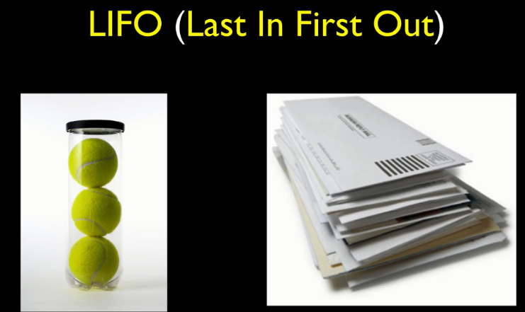
Stack in Real-World

Slide 4
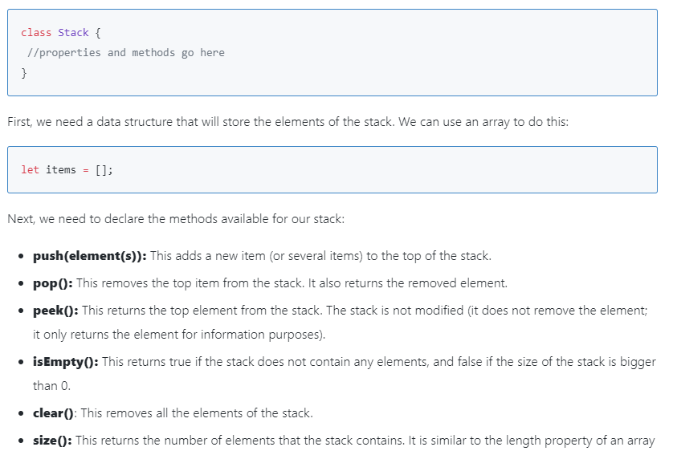
Creating a Stack

Slide 5
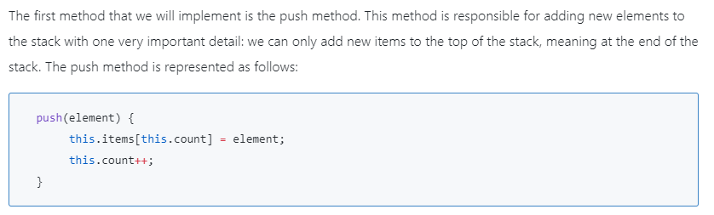
Pushing Elements To The Stack

Slide 6
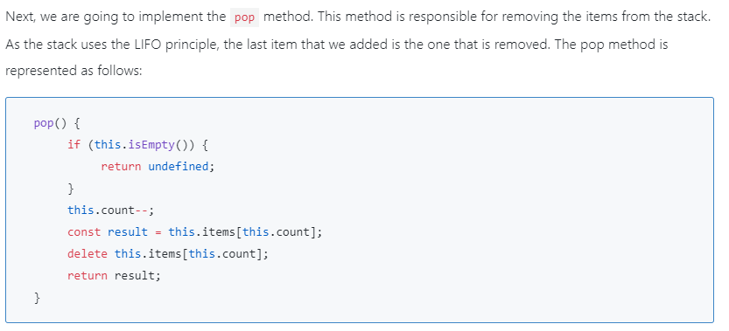
Popping Elements From The Stack

Slide 7
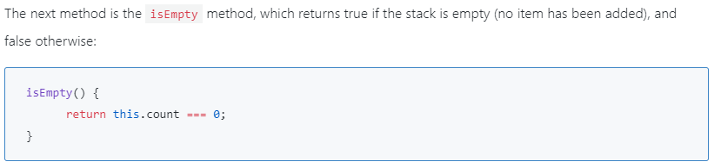
Verifying If The Stack Is Empty

Slide 8
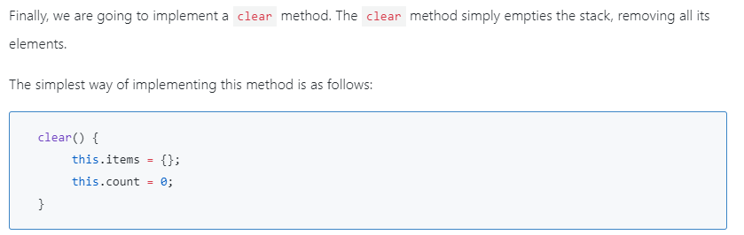
Clearing And Printing The Elements Of The Stack

Slide 9
